Slide 1


Executive Summary of Strengthening Local Health Grant
Presentation to the Hillsborough Township Committee
December 13, 2022
Hillsborough Community Outreach Team
Siobhan Spano, MS, HO, Health Officer
Lisa Harrison-Gulla MPH, MAE, HO, REHS, DrPH Candidate
Robin Vlamis, MPH, CHES
Mary Caputo, RN
Elena Cromeyer, MPH, DrPH Candidate
Tiffany Neal, MPH, MCHES
Rev. Tim Wolf, MA, Pioneer Family Success Center
vpgrant@hillsborough-nj.org

Slide 2



Background
Grant Funding
  December 2020
    Strengthening Local Public Health Capacity (NJDOH pass-through from CDC)
    Funding through June 30, 2021
  July 2021 – June 2022
    Strengthening Local Public Health
    Vaccination Supplemental Funding Grant
  July 2022 – June 2023
    Strengthening Local Public Health
    Vaccination Supplemental Funding Grant
Notes:
First round of funding required hiring of a VPOC coordinator(s) and conducting an assessment as well as connect vul populations with services ranging from social services to vaccine
Second round expands to include a COVID generalist with intentions of the grant continuing into 2023.
Additional grant for vaccination clinics

Slide 3

Updated Rapid Public Health Assessment
Timing: Conducted in September 2022
Focus: COVID-19, Influenza, Tick-borne illnesses,
and other local health disparities for future planning
Goals:
  Define and categorize populations disproportionately affected;
  Detail the community demographics;
  Describe the populations in need, health disparities, and community impacts of COVID-19, flu, and tick-borne illnesses;
  List community agencies that provide support to these disproportionately affected populations; and
  Summarize key findings and priorities.

Slide 4

Updated Rapid Public Health Assessment
Methods:
  Review and update all data sources
  Solicited feedback from Health Collaborative and
  key leaders:
    Hillsborough-Millstone Municipal Alliance
    Hillsborough School Principals and School Nurses
    Faith Based Leaders
    Hillsborough Social Services and Business Advocate
  Update findings and recommendations

Slide 5
Impacts of COVID-19
  As of Dec 2022: Total reported cases – 11,387 (actual cases much higher); Deaths - 113
  Severe disease and death burden much higher in seniors. 90% of deaths were in people over 65.
  Mental and emotional toll in both children and adults, but continued lack of access to mental health practitioners
  Falling behind in childhood immunizations
Physical and Mental Health
National trends show that the pandemic resulted in negative impacts on learning and test scores during the last 2 years.
Anecdotally, school staff have observed a gap in maturity and social-emotional development among students because of the pandemic.
Current district guidelines require students who test positive for COVID to stay home for 5 days, which will impact their learning.
Education
  Large uptick in business development in the last 6 months
  Shortage of workers in many settings: retail, daycare, restaurants, long term care, etc.
  Harder for Latinos without documentation to secure employment as well as services
  General lack of access to employment and workforce development services for young adults after high school graduation.
  Long Term Care Facilities having difficulty getting staff members to be vaccinated; difficult to find replacement staff
Employment

Slide 6
Impacts of COVID-19 (cont’d)
  Social Services noted an increase in requests for food in period of April to Sept in 2022 versus same period in 2021
  The American Rescue Plan Act (ARPA) funds are no longer available and low-income housing needs continue to be great. There is some local money available for Ida recovery through the Somerset Area Disaster Recovery Committee (SADRC).
Human/Social Services
  School lunches are no longer free – students must apply for Free and Reduced Lunch Program
  Based on input from faith-based leaders, faith-based organizations saw an increase in social isolation, loneliness, anxiety, depression, and family discord. The faith community relies on personal interactions for spiritual, emotional, and physical support.
  Lack of community infrastructure and public transportation is a major issue for families who do not have access to a car
Community Resources
  Disproportionate impact to Latinos, particularly those with low income
  Lack of representation of Black and Latino families at leadership level in town
Ethnic/Racial Disparities

Slide 7
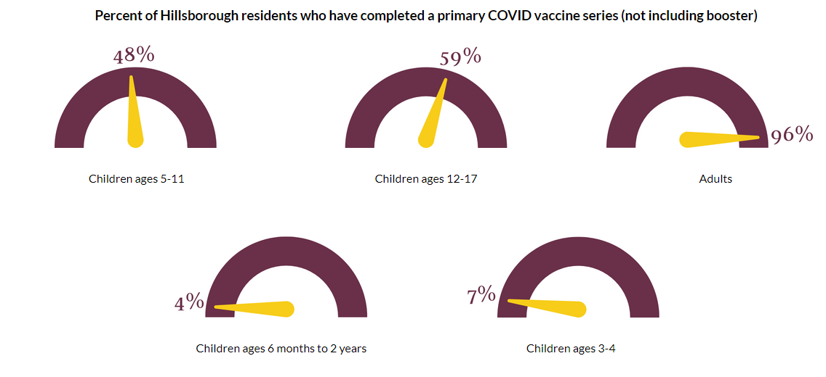
COVID-19 Vaccination in Hillsborough
Only 12% of our township population has received a bivalent booster dose. Without a recent booster, people are technically vaccinated but not protected.
For example, 7.6% of Twp population is Hispanic, and 7.1% of vaccinations given have been to Hispanics.
Data as of Nov 29, 2022

Slide 8

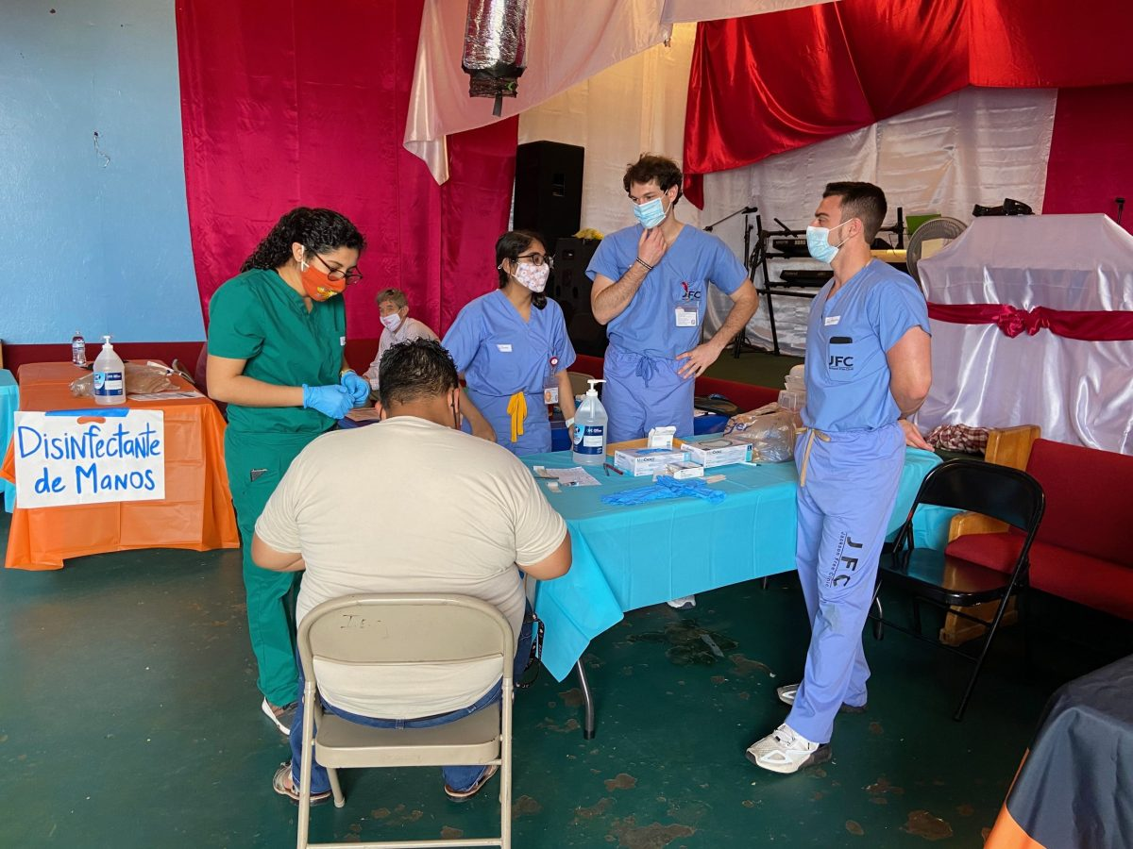
Influenza
Health Impact
Flu levels are HIGH in Somerset County and across the state, much earlier in the year as compared to previous years.
Populations Especially Affected
Seniors
Babies and Young children
Action Plan
Host flu clinics (~2 per month) and coordinate vaccinations for homebound residents
Offer infection control training at daycare/preschools and long-term care facilities
Immunocompromised and those with other chronic health conditions
Low-income workers with no paid time off
Promote prevention messages through various channels: wash your hands, cover your cough, stay home when sick, get vaccinated, seek treatment
Partner with local organizations (businesses, schools, pediatricians, affordable/senior housing complexes, faith-based groups, non-profits) to connect residents to services and spread prevention messages
Distribute masks, thermometers, and hand sanitizer to affected populations
School absenteeism is higher than normal.
Pregnant women
Flu can cause mild to severe illness, and at times can lead to death.
Emergency Department visits are significantly elevated compared to prior years. Hospitals across the country are very full, particularly pediatric units.
Additions: RSV was added to our grant as a disease focus last month.

Slide 9
Influenza (cont’d)
Rapid flu % Positive this year
We’ve never seen such high levels of influenza-like-illness at this time of year.

Slide 10
Tick-borne Illnesses
Health Impact
In 2019, NJ ranked third in most cases of Lyme Disease, a tickborne illness caused by the bacterium Borrelia burgdorferi and the most common vector-borne disease in the US, in the country and had the second highest rate, with 40.7 cases per 100,000.
Populations Especially Affected
People who spend time outdoors – camping, hiking, or working in grassy or wooded environments
Action Plan
Promote prevention messages through various channels: check your self/children/pets for ticks, wear long pants, use insect repellant, proper removal techniques
Partner with local organizations (businesses, schools, pediatricians, affordable/senior housing complexes, faith-based groups, non-profits, summer camps) to connect residents to services and spread prevention messages
Tickborne diseases pose a serious threat to the health of dogs and cats in Somerset County. Symptoms of these conditions can be painful and even be life-threatening for pet dogs and cats.
In Somerset County, ticks are active year round, with the greatest risk of spreading disease in the spring and early summer.
There were 70 cases (probable and confirmed) of Lyme disease in Hillsborough this year.
Post signage at outdoor spots (walking, biking trails) where ticks are likely to exist

Slide 11

Overall Action Plan
Hillsborough Health Collaborative
  Assist in guiding additional programs to address needs of community
  Connect to groups who work with vulnerable populations (churches, non-profits)
  Education and outreach at community events
Education/Information Sharing (school district e-mails, community events, doctors’ offices, social media, website, low-income workers) on topics, including:
  Where to Get Vaccinated and Tested for COVID/Flu in Hillsborough
  Infection Control / Disease Prevention
  Vaccine Hesitancy
  Explanation of isolation / quarantine guidance
  Avoiding and identifying ticks
Vaccination Clinics (Boosters, Ages 5+) and Homebound Visit Coordination
COVID home test kit distribution
  Social service clients, Seniors
  Apt complexes with affordable housing
  Businesses: Food service, manufacturers, personal care, home health aides
  Long Term Care Facilities and Group homes
Emergency Preparedness
  AAR
  Designing guides/documents to be used in future emergencies
Connecting Residents to Social Supports
Community Resource Directory Distribution
Continued Data Collection and Assessments

Slide 12

Thank you!
Questions? Please contact:
HILLSBOROUGH HEALTH COLLABORATIVE
908-369-5652
vpgrant@hillsborough-nj.org

